Slide 1
自然语言处理 Natural Language Processing
权小军 教授
中山大学数据科学与计算机学院
quanxj3@mail.sysu.edu.cn

Slide 2
Lecture 9: 语言模型（下）
Reference to Stanford CS224n

Slide 3
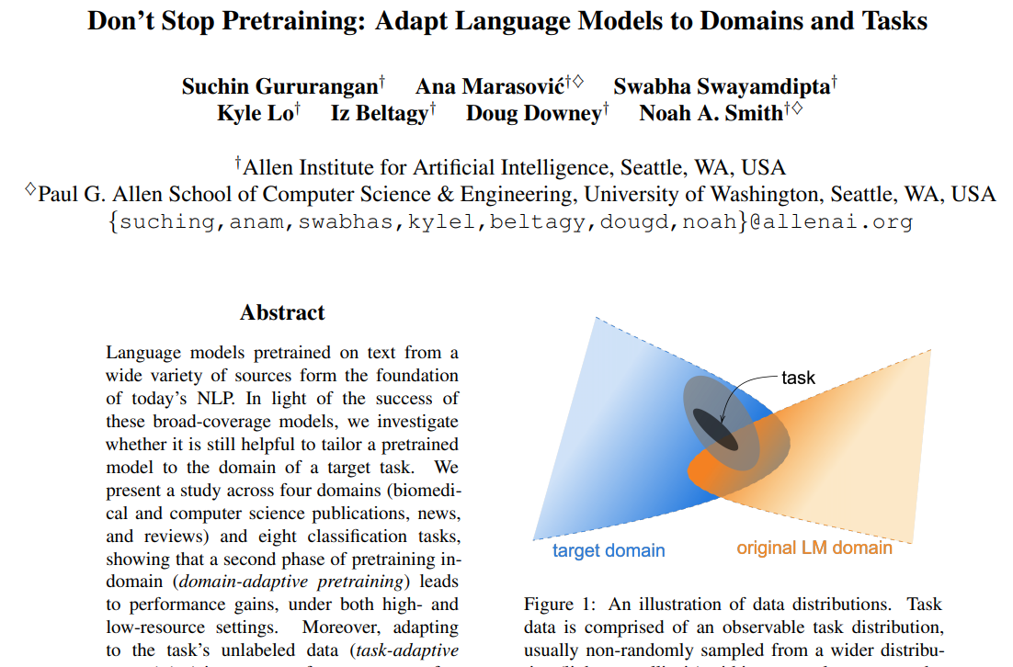

Slide 4
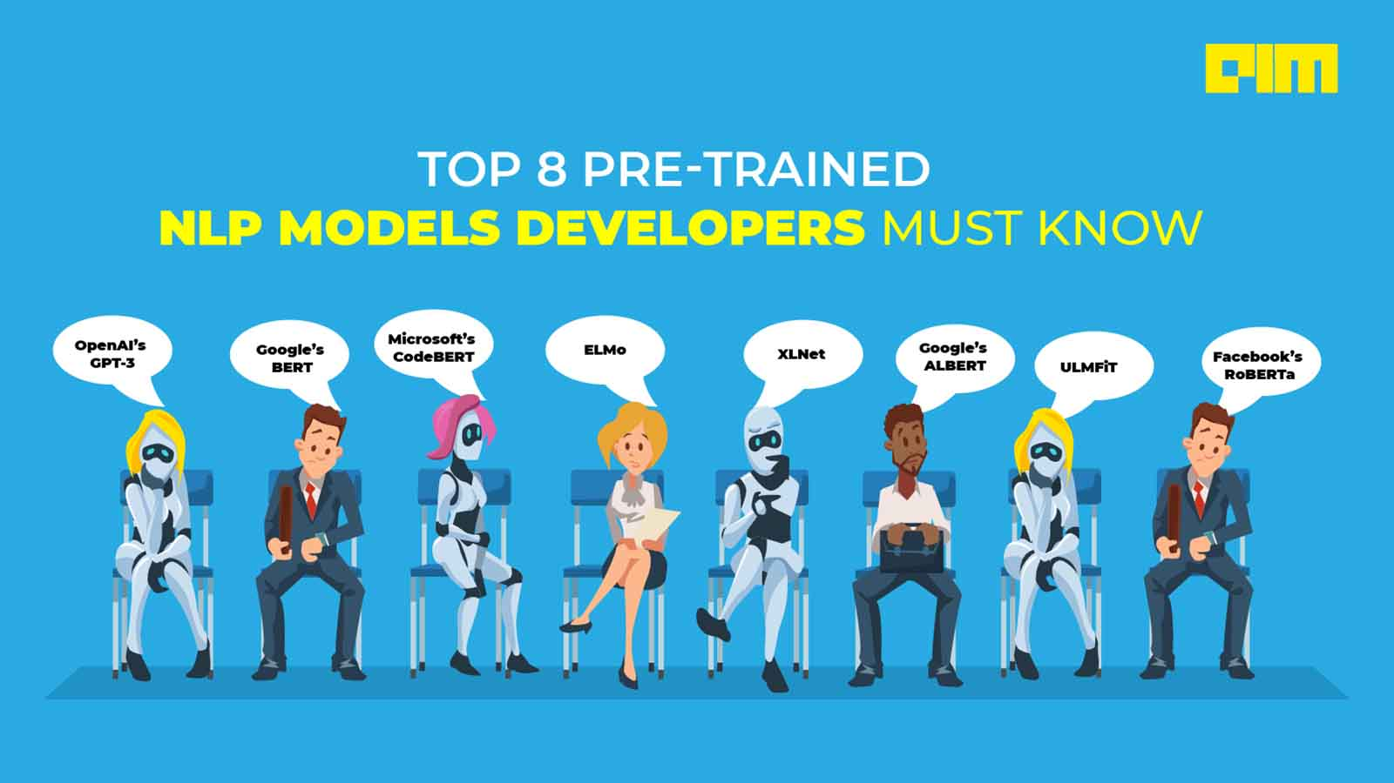

Slide 5
Lecture 9.1: Word Embeddings

Slide 6
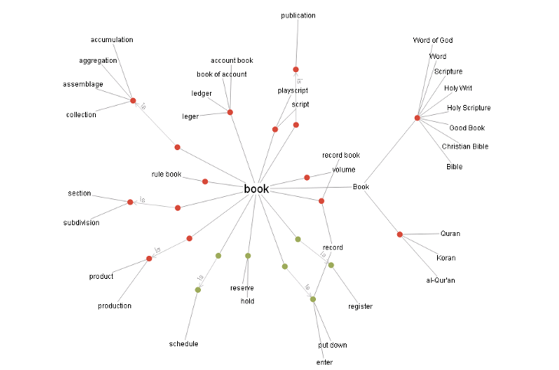
How do we have usable meaning in a computer?
Common solution: Use e.g. WordNet, a thesaurus containing lists of synonym sets and hypernyms (“is a” relationships).

Slide 7

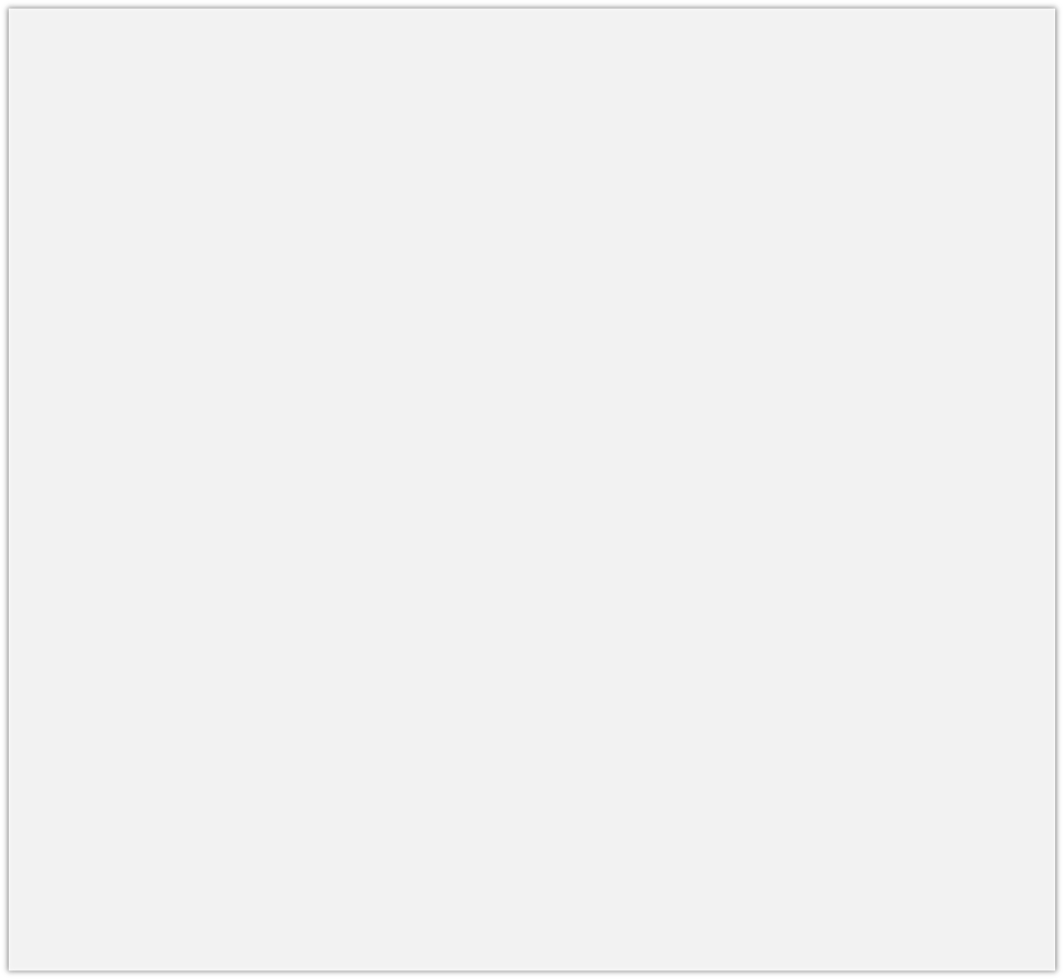
How do we have usable meaning in a computer?
Common solution: Use e.g. WordNet, a thesaurus containing lists of synonym sets and hypernyms (“is a” relationships).
e.g. synonym sets containing “good”: e.g. hypernyms of “panda”:
noun: good
noun: good, goodness noun: good, goodness
noun: commodity, trade_good, good
adj: good
adj (sat): full, good adj: good
adj (sat): estimable, good, honorable, respectable adj (sat): beneficial, good
adj (sat): good
adj (sat): good, just, upright
…
adverb: well, good
adverb: thoroughly, soundly, good
[Synset('procyonid.n.01'), Synset('carnivore.n.01'), Synset('placental.n.01'), Synset('mammal.n.01'), Synset('vertebrate.n.01'), Synset('chordate.n.01'), Synset('animal.n.01'), Synset('organism.n.01'), Synset('living_thing.n.01'), Synset('whole.n.02'),
Synset('object.n.01'), Synset('physical_entity.n.01'), Synset('entity.n.01')]

Slide 8
Problems with resources like WordNet
Great as a resource but missing nuance
e.g. “proficient” is listed as a synonym for “good”. This is only correct in some contexts.
Missing new meanings of words
e.g., wicked, badass, nifty, wizard, genius, ninja, bombest
Impossible to keep up-to-date!
Subjective
Requires human labor to create and adapt
Can’t compute accurate word similarity →

Slide 9
Representing words as discrete symbols
In traditional NLP, we regard words as discrete symbols: hotel, conference, motel – a localist representation
Means one 1, the rest 0s
Words can be represented by one-hot vectors:
motel = [0 0 0 0 0 0 0 0 0 0 1 0 0 0 0]
hotel = [0 0 0 0 0 0 0 1 0 0 0 0 0 0 0]
Vector dimension = number of words in vocabulary (e.g., 500,000)

Slide 10
Problem with words as discrete symbols
Sec. 9.2.2
Example: in web search, if user searches for “Seattle motel”, we would like to match documents containing “Seattle hotel”.
But:
motel = [0 0 0 0 0 0 0 0 0 0 1 0 0 0 0]
hotel = [0 0 0 0 0 0 0 1 0 0 0 0 0 0 0]
These two vectors are orthogonal.
There is no natural notion of similarity for one-hot vectors!
Solution:
Could try to rely on WordNet’s list of synonyms to get similarity?
But it is well-known to fail badly: incompleteness, etc.
Instead: learn to encode similarity in the vectors themselves

Slide 11
Representing words by their context
Distributional semantics: A word’s meaning is given by the words that frequently appear close-by
“You shall know a word by the company it keeps” (J. R. Firth 1957: 11)
One of the most successful ideas of modern statistical NLP!
When a word w appears in a text, its context is the set of words that appear nearby (within a fixed-size window).
Use the many contexts of w to build up a representation of w
…government debt problems turning into
…saying that Europe needs unified
…India has just given its
banking
banking banking
crises as happened in 2009…
regulation to replace the hodgepodge… system a shot in the arm…
These context words will represent banking

Slide 12
Word vectors
We will build a dense vector for each word, chosen so that it is similar to vectors of words that appear in similar contexts
0.286
0.792
−0.177
−0.107
0.109
−0.542
0.349
0.271
banking =
Note: word vectors are sometimes called word embeddings or word representations. They are a distributed representation.

Slide 13
Word vectors
“Distributed representation” means a many-to-many relationship between two types of representation (such as concepts and neurons).
Each concept is represented by many neurons
Each neuron participates in the representation of many concepts

Slide 14
Word2vec: Overview
Word2vec (Mikolov et al. 2013) is a framework for learning word vectors
Idea:
We have a large corpus of text
Every word in a fixed vocabulary is represented by a vector
Go through each position t in the text, which has a center word
c and context (“outside”) words o
Use the similarity of the word vectors for c and o to calculate the probability of o given c (or vice versa)
Keep adjusting the word vectors to maximize this probability

Slide 15
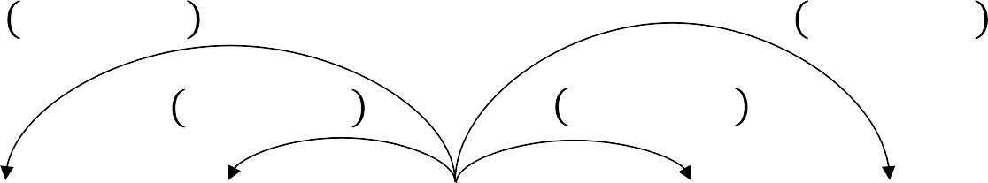
Word2vec: Overview
Example windows and process for computing 𝑃 𝑤_{t+j} | 𝑤_{t}
𝑃 𝑤 _{t - 2} | 𝑤 _{t}
𝑃 𝑤 _{t + 2} | 𝑤 _{t}
𝑃 𝑤 _{t - 1} | 𝑤 _{t}
𝑃 𝑤 _{t + 1} | 𝑤 _{t}
…
problems
turning
into
banking
crises
as
…
outside context words center word outside context words in window of size 2 at position t in window of size 2

Slide 16
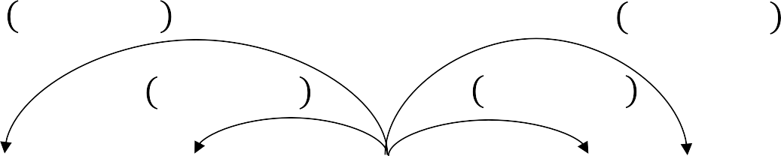
Word2vec: Overview
Example windows and process for computing 𝑃 𝑤_{t+j} | 𝑤_{t}
𝑃 𝑤 _{t - 2} | 𝑤 _{t}
𝑃 𝑤 _{t + 2} | 𝑤 _{t}
𝑃 𝑤 _{t - 1} | 𝑤 _{t}
𝑃 𝑤 _{t + 1} | 𝑤 _{t}
…
problems
turning
into
banking
crises
as
…
outside context words center word outside context words in window of size 2 at position t in window of size 2

Slide 17
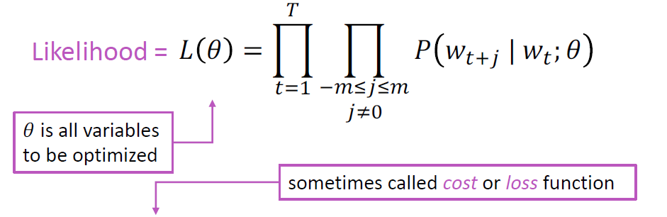
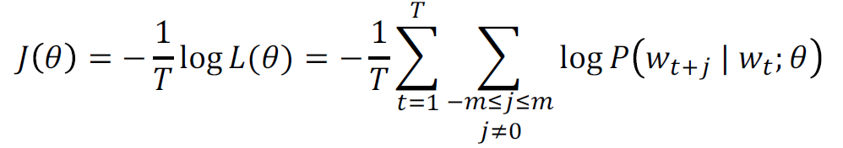
Word2vec: objective function
For each position 𝑡 = 1, … , 𝑇, predict context words within a window of fixed size m, given center word 𝑤_{j} .
The objective function 𝐽(𝜃) is the (average) negative log likelihood:
Minimizing objective function ⟺ Maximizing predictive accuracy

Slide 18
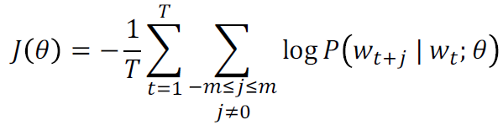
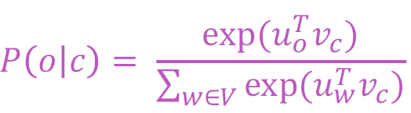
Word2vec: objective function
We want to minimize the objective function:
Question: How to calculate 𝑃(𝑤_{t+j} | 𝑤_{t}; 𝜃)?
Answer: We will use two vectors per word w:
𝑣_{w} when w is a center word
𝑢_{w} when w is a context word
Then for a center word c and a context word o:

Slide 19
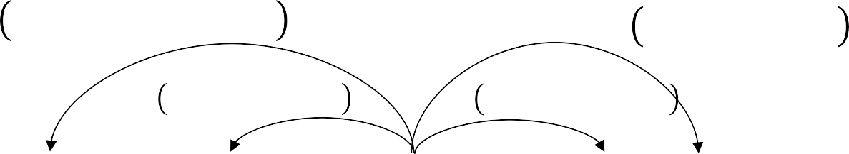
Calculating all gradients!
We went through gradient for each center vector v in a window
We also need gradients for outside vectors u
Generally in each window we will compute updates for all parameters that are being used in that window. For example:
^{𝑃 𝑢}turning^{|𝑣}banking
^{𝑃 𝑢}as ^{|𝑣}banking
^{𝑃 𝑢}crises^{|𝑣}banking
^{𝑃 𝑢}into ^{| 𝑣}banking
…
problems
turning
into
banking
crises
as
…
outside context words center word outside context words in window of size 2 at position t in window of size 2

Slide 20
Word2vec: More details
Why two vectors? → Easier optimization. Average both at the end.
Two model variants:
Skip-grams (SG)
Predict context (”outside”) words (position independent) given center word
Continuous Bag of Words (CBOW)
Predict center word from (bag of) context words
Additional efficiency in training:
1. Negative sampling

Slide 21
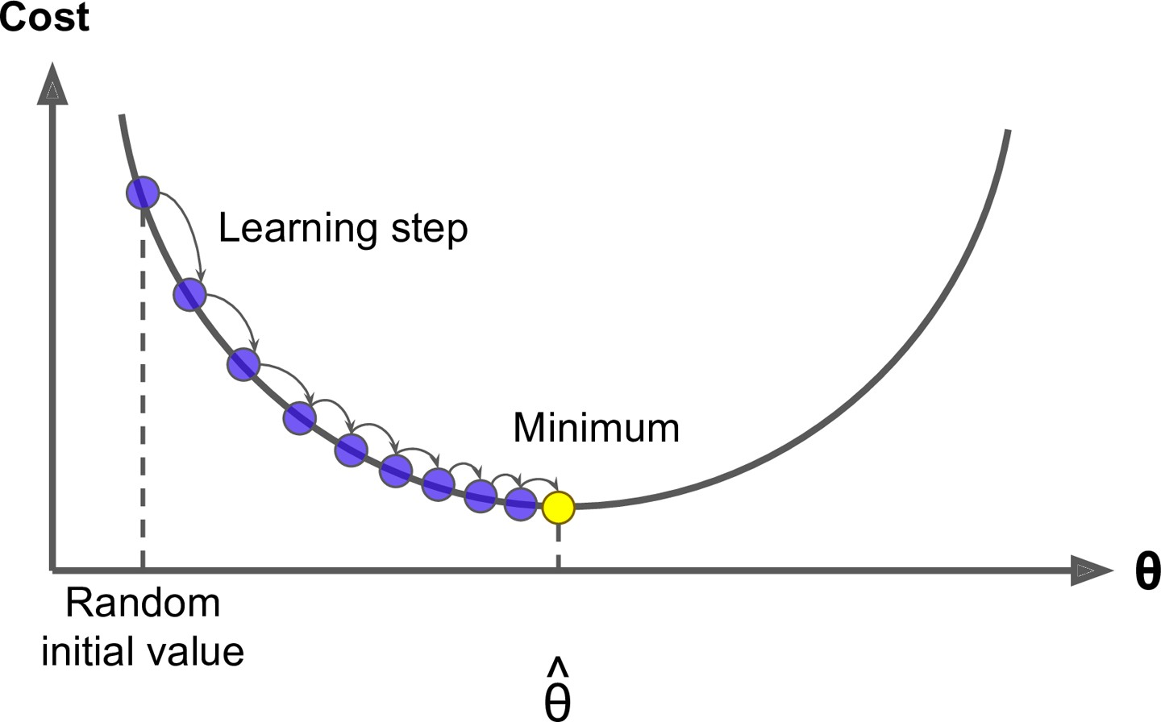
Optimization: Gradient Descent
We have a cost function 𝐽 𝜃 we want to minimize
Gradient Descent is an algorithm to minimize 𝐽 𝜃
Idea: for current value of 𝜃, calculate gradient of 𝐽 𝜃 , then take small step in direction of negative gradient. Repeat.

Slide 22
Lecture 9.2: Contextual Embeddings

Slide 23
Representations for a word
Originally, we basically had one representation of words:
The word vectors that we learned about at the beginning
Word2vec, GloVe, fastText
These have two problems:
Always the same representation for a word type regardless of the context in which a word token occurs
We might want very fine-grained word sense disambiguation
We just have one representation for a word, but words have different aspects, including semantics, syntactic behavior, and register/connotations

Slide 24
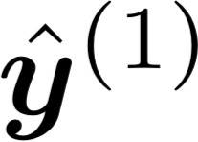
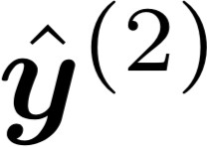
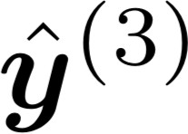
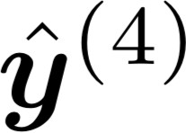


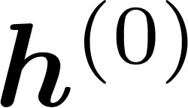
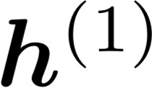
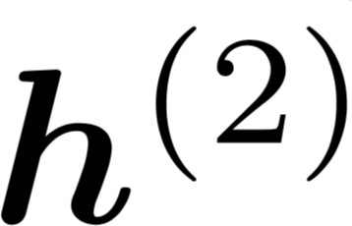
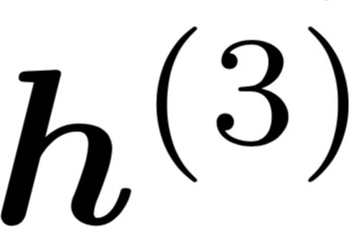
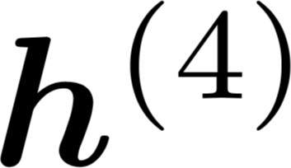
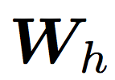

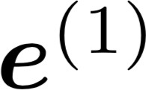
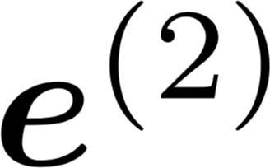
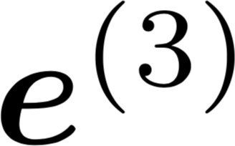
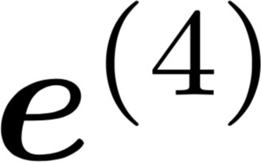
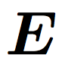
Did we all along have a solution to this problem?
In an NLM, we immediately stuck word vectors (perhaps only trained on the corpus) through LSTM layers
Those LSTM layers are trained to predict the next word
But those language models are producing context-specific word representations at each position!
favorite
sample
season
sample
is
spring
sample
sample
…
my
favorite
season
is
spring

Slide 25
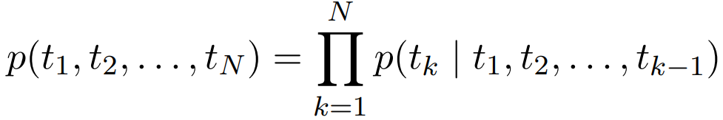
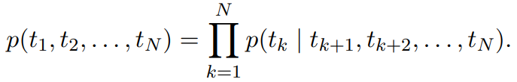
ELMo: Embeddings from Language Models
Deep contextualized word representations. NAACL 2018. https://arxiv.org/abs/1802.05365
Learn word token vectors using long contexts not context windows (here, whole sentence, could be longer)
Learn a deep Bi-NLM and use all its layers in prediction
Forward LM:
Backward LM:

Slide 26
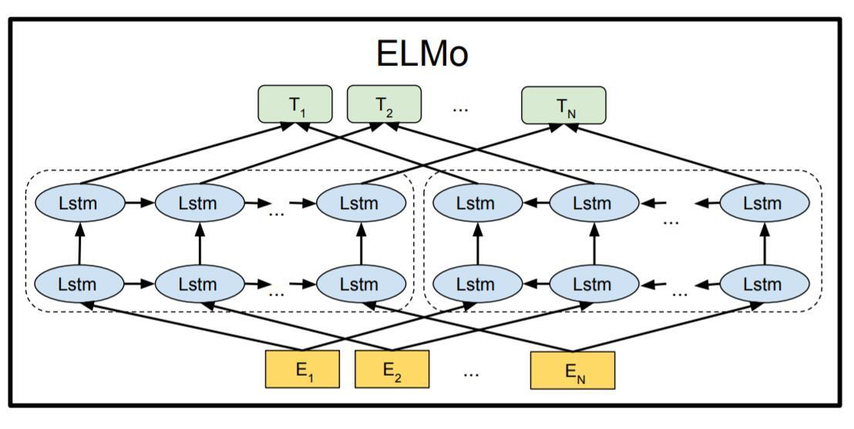
ELMo: Embeddings from Language Models
Train a bidirectional LM
Aim at performant but not overly large LM:
Use 2 biLSTM layers

Slide 27
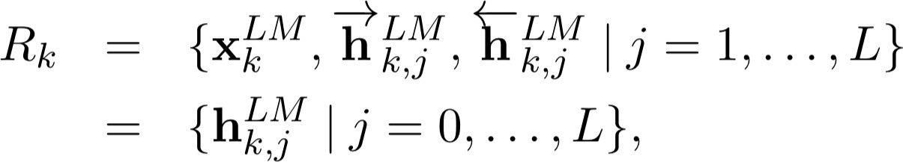
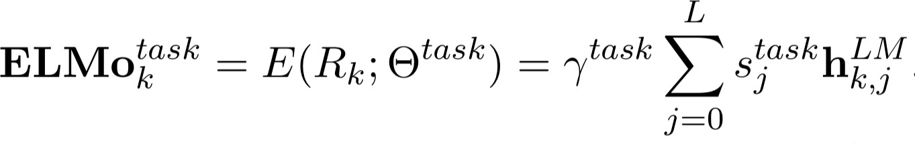
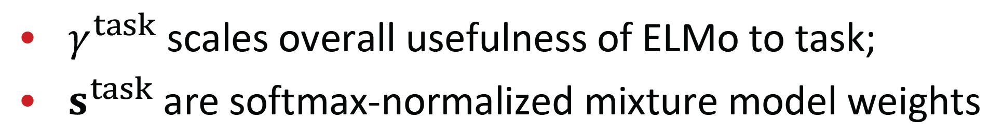
ELMo: Embeddings from Language Models
ELMo learns task-specific combo of biLM layer representations
This is an innovation that improves on just using top layer of LSTM stack

Slide 28
ELMo: Weighting of layers
The two biLSTM NLM layers have differentiated uses/meanings
Lower layer is better for lower-level syntax, etc.
Part-of-speech tagging, syntactic dependencies, NER
Higher layer is better for higher-level semantics
Sentiment, Semantic role labeling, question answering, SNLI
This seems interesting, but it’d seem more interesting to see how it pans out with more than two layers of network

Slide 29
Let’s scale it up!
All of these models are Transformer models
ELMo Oct 2017
Training: 800M words 42 GPU days
GPT
June 2018
Training 800M words 240 GPU days
BERT Oct 2018
Training 3.3B words
256 TPU days
~320–560
GPU days
GPT-2 Feb 2019
Training 40B words
~2048 TPU v3
days according to a reddit thread
XL-Net, ERNIE,
Grover RoBERTa, T5
July 2019—

Slide 30



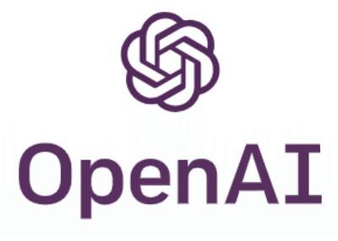



Transformer models
All of these models are Transformer models
ELMo Oct 2017
Training: 800M words 42 GPU days
GPT
June 2018
Training 800M words 240 GPU days
BERT Oct 2018
Training 3.3B words
256 TPU days
~320–560
GPU days
GPT-2 Feb 2019
Training 40B words
~2048 TPU v3
days according to a reddit thread
XL-Net, ERNIE,
Grover RoBERTa, T5
July 2019—

Slide 31
Lecture 9.3: Transformer

Slide 32
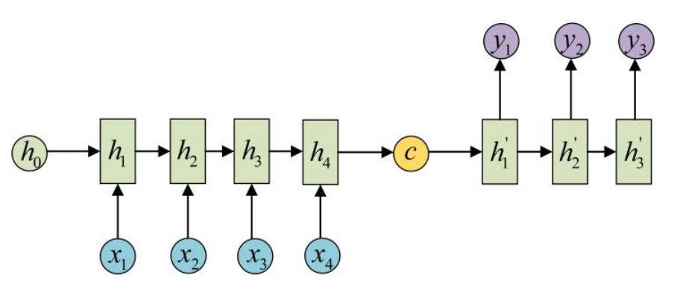
RNN and Attention
Encoder-Decoder结构

Slide 33
RNN and Attention
Attention机制
在Encoder-Decoder结构中，Encoder把所有的输入序列都编码成一个统一的语义特征c再解码，因此， c中必须包含原始序列中的所有信息，句子的长度就成了限制模型性能的瓶颈。如机器翻译问题，当要翻译的句子较长时，一个c可能存不下那么多信息，就会造成翻译精度的下降。

Slide 34
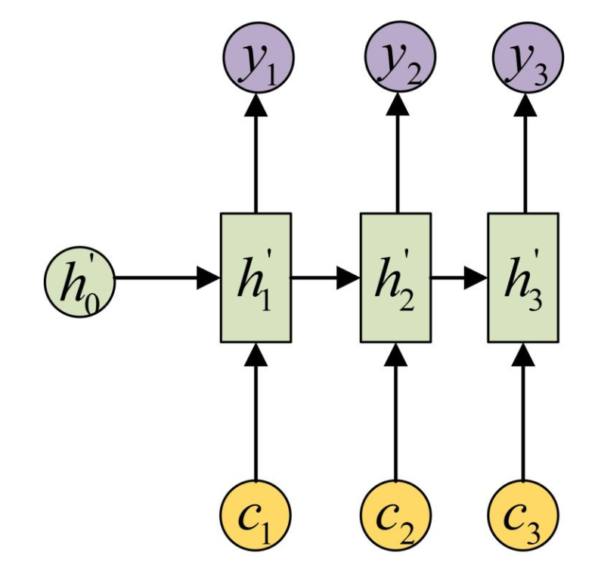
RNN and Attention
Attention机制
Attention机制通过在每个时间输入不同的c来解决这个问题

Slide 35
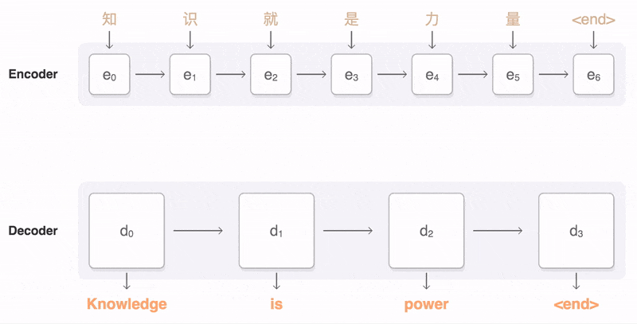
RNN and Attention

Slide 36
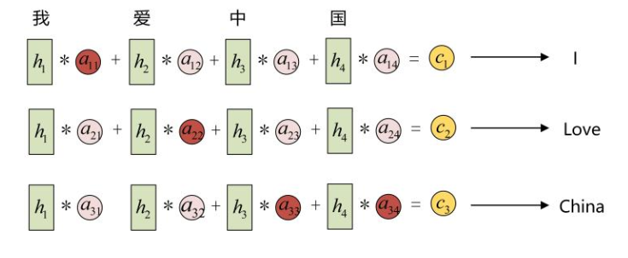
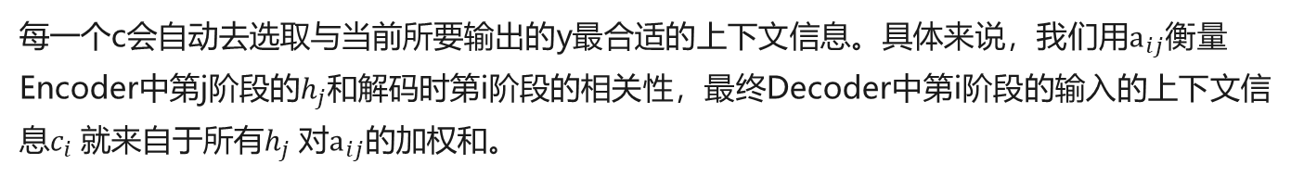
RNN and Attention
Attention机制
每一个c会自动去选取与当前所要输出的y最合适的上下文信息。具体来说，我们用$a_{ij}$衡量Encoder中第j阶段的$h_{j}$和解码时第i阶段的相关性，最终Decoder中第i阶段的输入的上下文信息$c_{i}$就来自于所有$h_{j}$对$a_{ij}$的加权和。

Slide 37
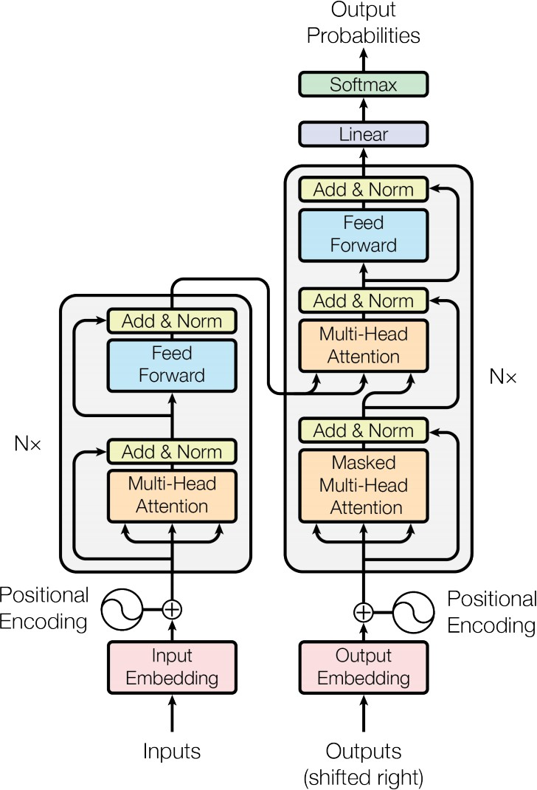
The Transformer
Attention is all you need. 2017. Vaswani, Shazeer, Parmar, Uszkoreit, Jones, Gomez, Kaiser, Polosukhin https://arxiv.org/pdf/1706.03762.pdf
Non-recurrent sequence-to- sequence encoder-decoder model
Task: machine translation with parallel corpus
Predict each translated word
Final cost/error function is standard cross-entropy error on top of a softmax classifier

Slide 38
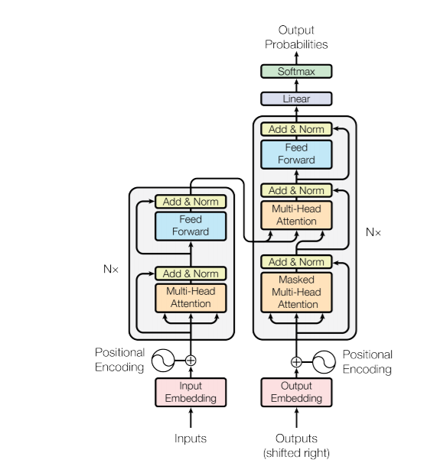
Transformer
Transformer—模型结构
Cross attention
Encoder
Decoder
Self attention

Slide 39
Self attention
h x
…
…
Q₀
K₀
V₀
Q₁
K₁
V₁
Q₂
K₂
V₂
Q₃
K₃
V₃
Q₄
K₄
V₄
^{h}0,0
^{h}0,1
^{h}0,2
^{h}0,3
^{h}0,4
+
+
+
+
+
[CLS]
0
Judiciary
1
Committee
2
[MASK]
3
Report
4

Slide 40
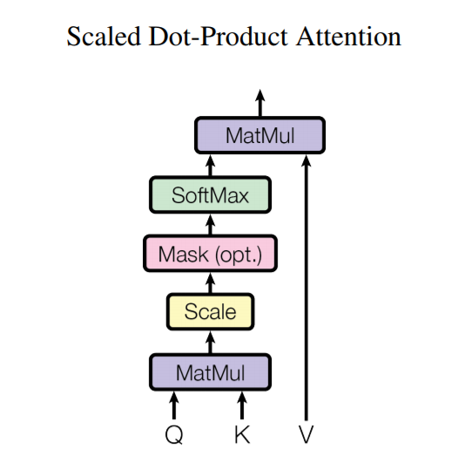
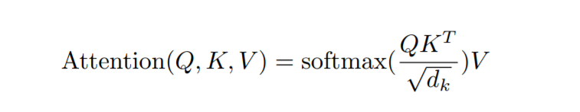
Transformer
Transformer——Attention模块
当Q，K，V来自同一个序列时就是self attention，当来自两个不同的序列时就是cross attention
能够完全并行
Attention权重，在自中自注意力中就是输入token之间的相关性

Slide 41
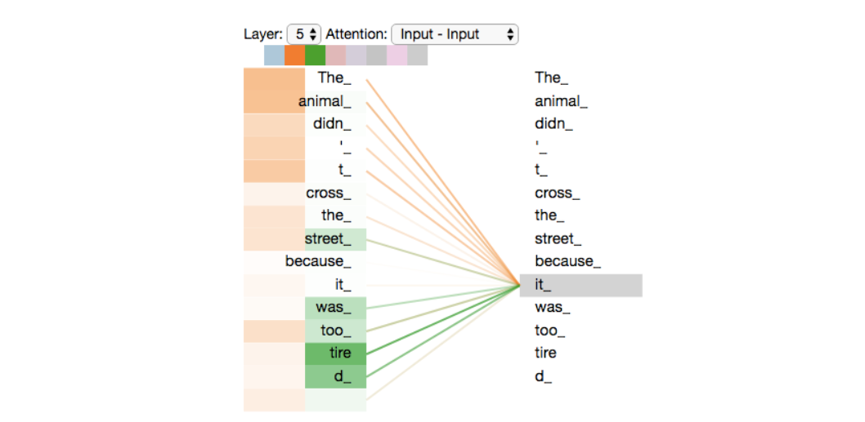
Transformer
Transformer——Attention模块
多头自注意力可视化

Slide 42
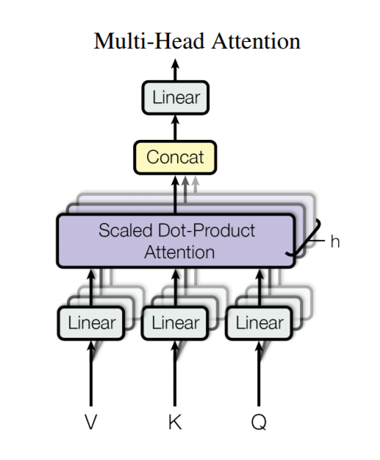
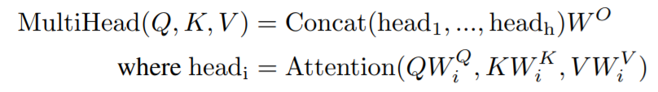
Transformer
Transformer——MultiHead机制
每个head可以学习不同的知识

Slide 43
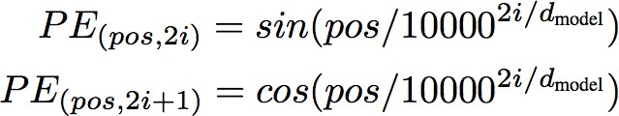
Encoder Input
Also added is a positional encoding so same words at different locations have different overall representations:

Slide 44
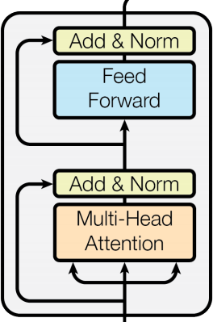
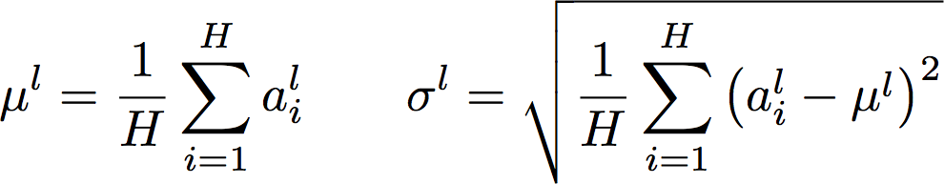
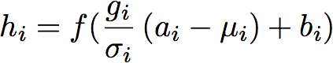
Complete transformer block
Each block has two “sublayers”
Multihead attention
2-layer feed-forward NNet (with ReLU)
Each of these two steps also has:
Residual (short-circuit) connection and LayerNorm LayerNorm(x + Sublayer(x))
Layernorm changes input features to have mean 0 and variance 1 per layer (and adds two more parameters)
Layer Normalization by Ba, Kiros and Hinton, https://arxiv.org/pdf/1607.06450.pdf

Slide 45


Complete Encoder
Blocks are repeated 6 or more times
(in vertical stack)

Slide 46


Transformer Decoder
2 sublayer changes in decoder
Masked decoder self-attention on previously generated outputs:
Encoder-Decoder Attention, where queries come from previous decoder layer and keys and values come from output of encoder
Blocks repeated 6 times also

Slide 47

Transformer
机器翻译上取得sota的结果

Slide 48
Lecture 9.4: BERT

Slide 49
BERT
BERT (Bidirectional Encoder Representations from Transformers):
Pre-training of Deep Bidirectional Transformers for Language Understanding, which is then fine-tuned for a task
Want: truly bidirectional information flow without leakage in a deep model
Solution #1: Use a cloze task formulation where 15% of words are blanked out and predicted:
store
↑
gallon
↑
the man went to the [MASK] to buy a [MASK] of milk

Slide 50

BERT
Solution #2: Next Sentence Prediction

Slide 51

BERT sentence pair encoding
Token embeddings are word pieces
Learned segmented embedding represents each sentence
Positional embedding is as for other Transformer architectures

Slide 52
BERT model architecture and training
Transformer encoder (as before)
Self-attention ⇒ no locality bias
Long-distance context has “equal opportunity”
Single multiplication per layer ⇒ efficiency on GPU/TPU
Train on Wikipedia + BookCorpus
Train 2 model sizes:
BERT-Base: 12-layer, 768-hidden, 12-head
BERT-Large: 24-layer, 1024-hidden, 16-head
Trained on 4x4 or 8x8 TPU slice for 4 days

Slide 53

BERT model fine tuning
Simply learn a classifier built on the top layer for each task that you fine tune for

Slide 54

BERT model fine tuning

Slide 55
Rapid Progress from Pre-Training (GLUE benchmark)
90
RoBERTa
ALBERT
XLNet
BERT-Large
BERT-Base
GPT
ELMo
GloVe
GLUE Score
60
Over 3x reduction in error in 2 years, “superhuman” performance

Slide 56
We now have strongly performing, deep, generic, pre-trained, neural network stacks for NLP that you can just load– in the same way vision has had (ResNet, etc.)!

Slide 57

But let’s change the x-axis to compute …
90
1.9e20 FLOPs
BERT-Large
6.4e19 FLOPs
BERT-Base
GLUE Score
GPT
ELMo
GloVe
60
Pre-Train FLOPs
BERT-Large uses 60x more compute than ELMo

Slide 58
But let’s change the x-axis to compute …
90
≈ RoBERTa
XLNet
ç
BERT-Large
BERT-Base GPT
GLUE Score
ELMo
GloVe
60
Pre-Train FLOPs
RoBERTa uses 16x more compute than BERT-Large

Slide 59
More compute, more better?
90
≈ RoBERTa
≈ ALBERT
XLNeçt
ç
BERT-Large
BERT-Base GPT
GLUE Score
ELMo
GloVe
60
Pre-Train FLOPs
ALBERT uses 10x more compute than RoBERTa

Slide 60
Thank you!
权小军 中山大学数据科学与计算机学院

